Slide 1
Chemical Kinetics Chapter 8
1.

Slide 3
Chemical Kinetics
We will now study:
Kinetics: the study of how fast chemical reactions occur.
(in contrast to Thermodynamics: which determines if a reaction take place)
Speed of a reaction: is measured by the change in concentration with time.
Important factors which affect rates of reactions:
reactant concentration
temperature
action of catalysts
surface area
pressure of gaseous reactants or products

Slide 4
Reaction Rate
For the reaction A → B there are two ways of measuring rate:
(1) the speed at which the reactants disappear
(2) the speed at which the products appear
The rate of the reaction is the change in concentration of any reactants or products per unit time.
rate of the reaction = rate of disappearance of A
= rate of appearance of B
d[A]
rate = -
dt
d[B]
rate =
dt

Slide 5
Can you explain why food is remains fresh in deep freeze compartment.
Due to low temperature rotten reaction is very much slow. So food remains fresh during log time.

Slide 6
Rate Law
Each reaction has its own equation that gives its rate as a function of reactant concentrations.
This is called its Rate Law
The rate of reaction is directly proportional to the reactant concentration
The general form of the rate law is
A → B, Rate ∞ [A]
Rate = k[A]
Concertation being raised to some power.
Rate = k[A]^{n ,} k is a rate constant
2A + B → Product ,
Rate = k [A]²[B]
6.

Slide 7


Rate Law
NH₄⁺ (aq) + NO₂⁻ (aq) → N₂ (g) + 2H₂O (l)
This equation is called the rate law, and k is the rate constant.
2N₂O₅ → 4NO₂ + O₂
H₂ + I₂ → 2HI
2NO + 2 H₂ → N₂ + 2H₂O
7.

Slide 8
Order of reaction
From rate law:
Exponents tell the order of the reaction with respect to each reactant.
The sum of powers of concentrations in the rate law.
NH₄⁺ (aq) + NO₂⁻ (aq) → N₂ (g) + 2H₂O (l)
This reaction is
First-order in [NH₄⁺]
First-order in [NO₂⁻]
The overall reaction order can be found by adding the exponents on the reactants in the rate law.
This reaction is second-order overall.
Rate = K [NH₄⁺ ]¹[NO₂⁻ ]¹
reaction order 1+1 = 2
8.

Slide 9
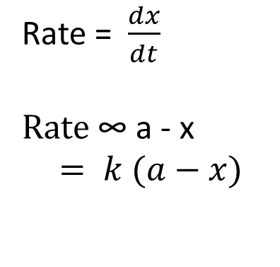

Integrated rate equation for first order reaction
Lets a 1st order reaction, A → B
t = 0, a 0
t = t, a-x x
For first order reaction, Rate of reaction is dx/dt is directly proportional to the concentration of reactants.
So, $\frac{dx}{dt}=k \left(a−x\right)$
or, $\frac{dx}{a−x}=k dt$
Taking integration$, \int{\frac{dx}{a−x}}=\int{kdt}$
or, -ln (a-x) = kt + I
Rate = $\frac{dx}{dt}$
Rate ∞ a - x
$$= k (a−x)$$
9.

Slide 10

Where I is the integration constant. The constant k may be calculated by putting t = 0, x = 0 , thus, I = -ln a. Substituting for I in equation (i),
-ln (a-x) = kt - ln a
or, ln a – ln a-x = kt
or, ln $\frac{a}{a−x}= kt$
Changing into common logarithm
k = $\frac{1}{t} . 2.303log\frac{a}{ a−x}$
That is the order rate equation.

Slide 11
Examples of first order reactions
Decomposition of H₂O₂ in aqueous solution
H₂O₂ → H₂O + 1/2 O₂
Hydrolysis of methyl acetate in presence of mineral acids
CH₃COOCH₃ + H₂O → CH₃COOH + CH₃OH
Inversion of cane sugar in presence of mineral acids
C₁₂H₂₂O₁₁ + H₂O C₆H₁₂O₆ + C₆H₁₂O₆
Decomposition of ammonium nitrite in aqueous solution
NH₄NO₂ → N₂ + 2H₂O

Slide 12
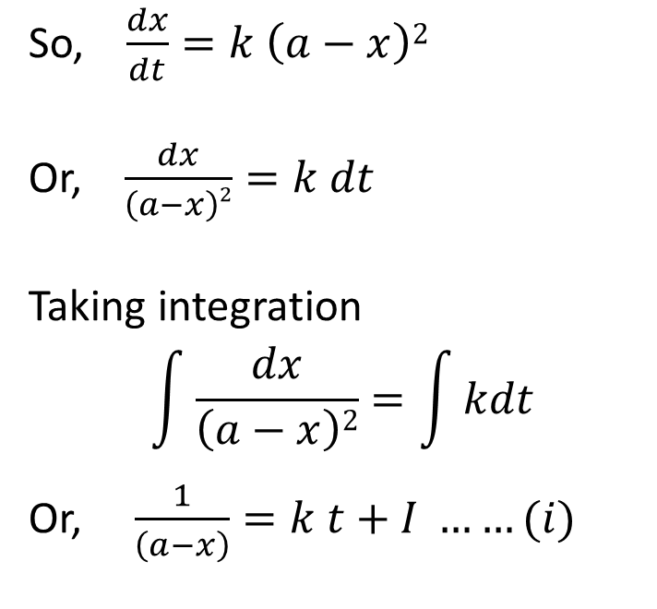
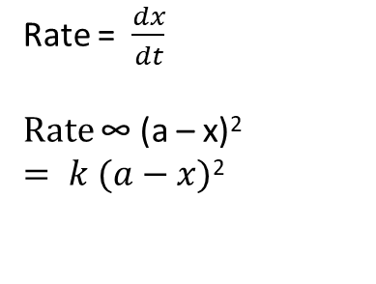
Rate equation for second order reaction
2 A → product
t = 0, a 0
t = t, a-x x
For first order reaction, Rate of reaction is dx/dt is directly proportional to the concentration of reactants.
So, $\frac{dx}{dt}=k \left(a−x\right)2$
Or, $\frac{dx}{\left(a−x\right)2}=k dt$
Taking integration
$$\int{\frac{dx}{\left(a−x\right)2}}=\int{kdt}$$
Or, $\frac{1}{\left(a−x\right)}=k t+I ……(i)$
Rate = $\frac{dx}{dt}$
Rate ∞ (a – x)²
$= k (a−x)$²

Slide 13

I is an integration constant. The constant I ay be evaluated by putting t = 0, and x= 0, thus
I = 1/a, Substituting value of I, then from equation (i)
$$\frac{1}{\left(a−x\right)}=k t+\frac{1}{a}$$
Or, $k t =\frac{1}{\left(a−x\right)}−\frac{1}{a}$
Or, $k =\frac{1}{t}.\frac{x}{a\left(a−x\right)}$
This is the second order reaction rate equation

Slide 14
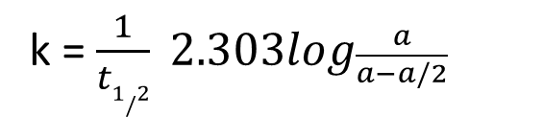
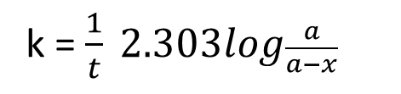
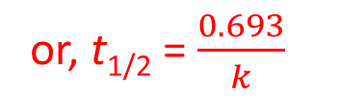
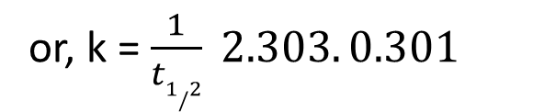
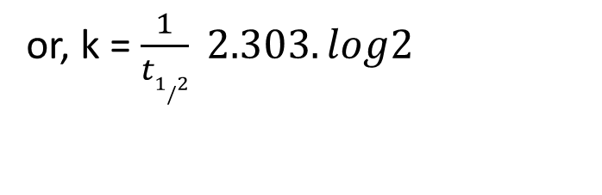
Half-Time or Half-Life Period of Reaction
half-life, t_{½}, is the time required for the concentration of a reactant to decrease to half of its initial concentration.
It is denoted by the symbol t_{1/2}. Thus,
For first order reaction, we know that
k = $\frac{1}{t} 2.303log\frac{a}{a−x}$
At half life of a first order reaction, t = t_{1/2} x = a/2 ,
k = $\frac{1}{t1/2} 2.303log\frac{a}{a−a/2}$
or, t_{1/2} = $\frac{0.693}{k}$
or, k = $\frac{1}{t1/2} 2.303.log2$
NOTE: For a first-order process, the half-life does not depend on a
or, k = $\frac{1}{t1/2} 2.303. 0.301$

Slide 15
What is the half-life of N₂O₅ if it decomposes with a rate constant of 5.7 x 10⁻⁴ s⁻¹?
0.693
t_{½}
=
k
0.693
=
5.7 x 10⁻⁴ s⁻¹
= 1200 s
= 20 minutes

Slide 16
Zero-Order Reactions
A product
Δ[A]_{t}
rate = -
Δt
[A]_{t} is the concentration of A at any time t
[A]_{t} - [A]₀ = kt
[A]₀ is the concentration of A at time t=0
For Zero order reactions:
Rate = k[A]₀ = k
Rate does not change with concentration.
So… [A]_{t} = -kt + [A]₀
where [A]_{t} = concentration of [A] after some time, t
k= reaction rate constant in units of M/s
t= time in seconds
[A]_{o} = initial concentration of A
Half life for zero order
t_{½} = t when [A]_{t} = [A]₀/2
[A]₀
t_{½} =
2k

Slide 17
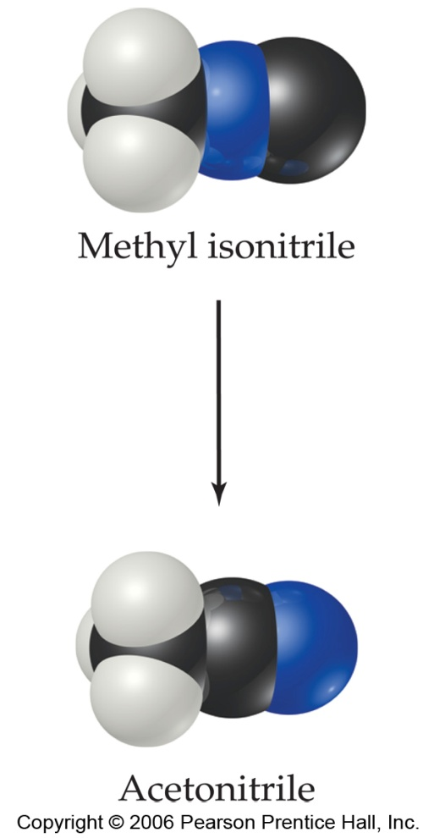
First-Order Processes
Consider the process in which methyl isonitrile is converted to acetonitrile.
CH₃NC
CH₃CN
How do we know this is a first order reaction?
17.

Slide 18
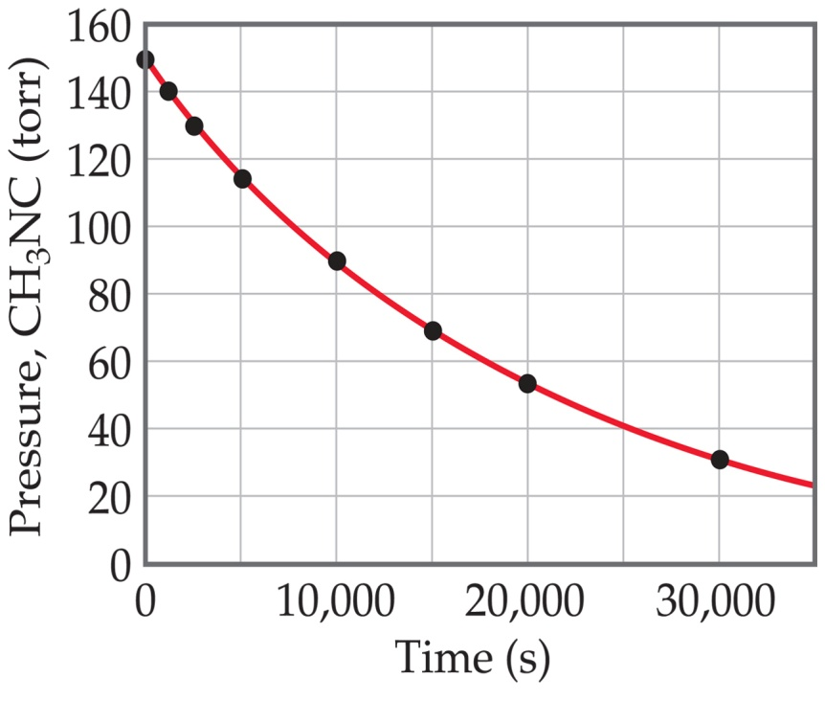
First-Order Processes
CH₃NC
CH₃CN
This data was collected for this reaction at 198.9°C.
Does
rate=k[CH₃NC]
for all time intervals?
18.

Slide 19
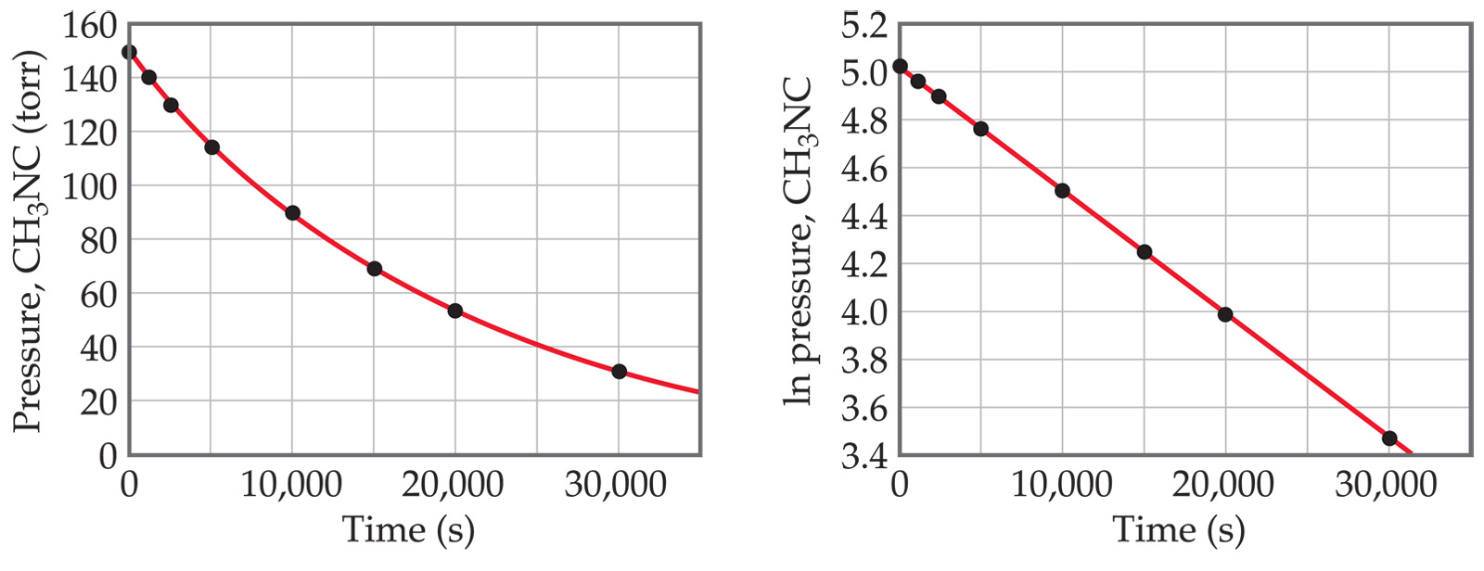

First-Order Processes
When ln P is plotted as a function of time, a straight line results.
The process is first-order.
k is the negative slope: 5.1 × 10⁻⁵ s⁻¹.
19.

Slide 20
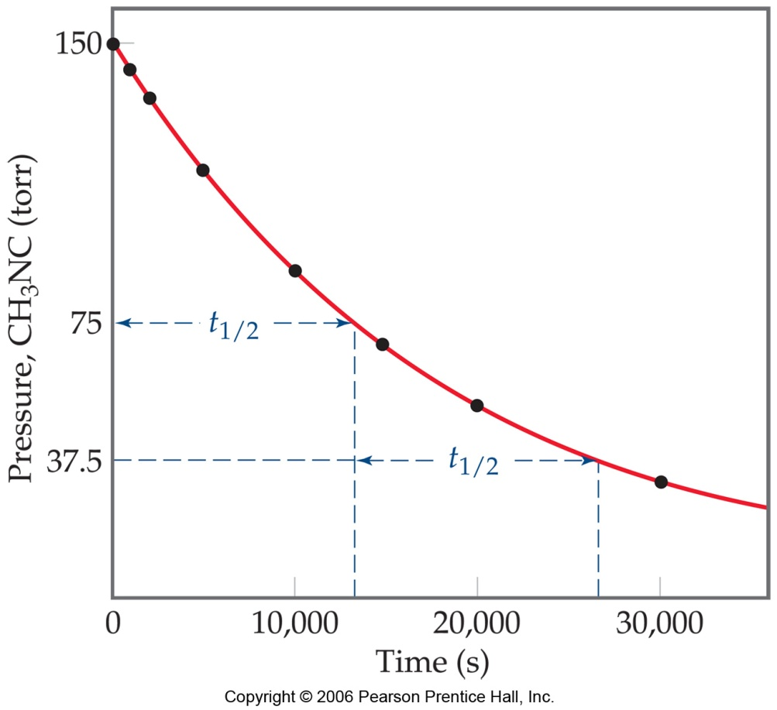
Half-Life of a Reaction
Half-life is defined as the time required for one-half of a reactant to react.
Because [A] at t_{1/2} is one-half of the original [A],
[A]_{t} = 0.5 [A]₀.
20.

Slide 21




Half-Life of a First Order Reaction
For a first-order process, set [A]_{t}=0.5 [A]₀ in integrated rate equation:
NOTE: For a first-order process, the half-life does not depend on the initial concentration, [A]₀.
21.

Slide 22
First Order Rate Calculation
Example 1: The decomposition of compound A is first order. If the initial [A]₀ = 0.80 mol dm⁻³. and the rate constant is 0.010 s⁻¹, what is the concentration of [A] after 90 seconds?
22.

Slide 23
First Order Rate Calculation
Example 1: The decomposition of compound A is first order. If the initial [A]₀ = 0.80 mol dm⁻³. and the rate constant is 0.010 s⁻¹, what is the concentration of [A] after 90 seconds?
Ln[A]_{t} – ln[A]_{o} = -kt
Ln[A]_{t} – Ln[0.80] = - (0.010 s⁻¹ )(90 s)
Ln[A]_{t} = - (0.010 s⁻¹ )(90 s) + ln[0.80]
Ln[A]_{t} = -0.90 - 0.2231
ln[A]_{t} = -1.1231
[A]_{t} = 0.325 mol dm⁻³
23.

Slide 25
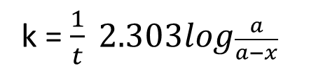
First Order Rate Calculation
Example 1: A first order reaction takes 20 min for 15% completion. Calculate the rate constant and how long it takes to 60% completion.
k = $\frac{1}{t} 2.303log\frac{a}{a−x}$
Ln[A]_{t} – ln[A]_{o} = -kt
Ln[A]_{t} – Ln[0.80] = - (0.010 s⁻¹ )(90 s)
Ln[A]_{t} = - (0.010 s⁻¹ )(90 s) + ln[0.80]
Ln[A]_{t} = -0.90 - 0.2231
ln[A]_{t} = -1.1231
[A]_{t} = 0.325 mol dm⁻³
25.

Slide 26
First Order Rate Calculations
Example 2: A certain first order chemical reaction required 120 seconds for the concentration of the reactant to drop from 2.00 M to 1.00 M. Find the rate constant and the concentration of reactant [A] after 80 seconds.
26.

Slide 27
First Order Rate Calculations
Example 2: A certain first order chemical reaction required 120 seconds for the concentration of the reactant to drop from 2.00 M to 1.00 M. Find the rate constant and the concentration of reactant [A] after 80 seconds.
Solution
k =0.693/t_{1/2} =0.693/120s =0.005775 s⁻¹
Ln[A] – Ln(2.00) = -0.005775 s⁻¹ (80 s)= -0.462
ln A = - 0.462 + 0.693 = 0.231
A = 1.26 mol dm⁻³
27.

Slide 28
First order Rate Calculations
Example 3: Radioactive decay is also a first order process. Strontium 90 (⁹⁰ Sr) is a radioactive isotope with a half-life of 28.8 years. If some strontium 90 were accidentally released, how long would it take for its concentration to fall to 1% of its original concentration?
28.

Slide 29

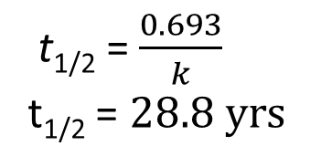
First Order Rate Calculations
Example 3: Radioactive decay is also a first order process. Strontium 90 is a radioactive isotope with a half-life of 28.8 years. If some strontium 90 were accidentally released, how long would it take for its concentration to fall to 1% of its original concentration?
t_{1/2} = $\frac{0.693}{k}$
t_{1/2} = $28.8 yrs$
Solution
k =0.693/t_{1/2} =0.693/28.8 yr =0.02406 yr⁻¹
Ln[1] – ln(100) = - (0.02406 yr⁻¹)t = - 4.60
t = - 4.60 .
- 0.0241 yr⁻¹
t = 191 years
k = $\frac{1}{t} . 2.303log\frac{a}{ a−x}$
k = 0.024 yr⁻¹
^{t = ?}
^{a = 100}
^{X = 1}
29.

Slide 30

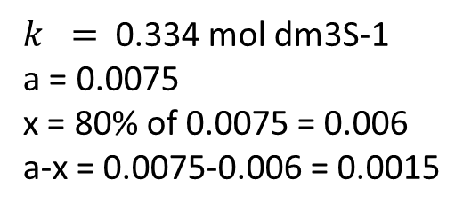

Problem 1: Second Order Reaction
Acetaldehyde, CH₃CHO, decomposes by second-order kinetics with a rate constant of 0.334 mol⁻¹dm³s⁻¹ at 500ºC. Calculate the amount of time it would take for 80 % of the acetaldehyde to decompose in a sample that has an initial concentration of 0.00750 M.
$k =\frac{1}{t}.\frac{x}{a\left(a−x\right)}$
The final concentration will be 20% of the original 0.00750 M or = 0.00150
$k =$ 0.334 mol dm3S-1
a = 0.0075
x = 80% of 0.0075 = 0.006
a-x = 0.0075-0.006 = 0.0015
1 .
.00150
1 .
.00750
= 0.334 mol⁻¹dm³s⁻¹ t +
666.7 = 0.334 t + 133.33
0.334 t = 533.4
t = 1600 seconds
30.

Slide 31
Sample Problem 2: Second Order
Acetaldehyde, CH₃CHO, decomposes by second-order kinetics with a rate constant of 0.334 mol⁻¹dm³s⁻¹ at 500ºC. If the initial concentration of acetaldehyde is 0.00200 M. Find the concentration after 20 minutes (1200 seconds)
Solution
1 .
[A]_{t}
1 .
0.00200 mol dm⁻³
= 0.334 mol⁻¹dm³s⁻¹ (1200s) +
1 .
[A]_{t}
= 0.334 mol⁻¹dm³ s⁻¹ (1200s) + 500 mol⁻¹dm³
= 900.8 mol⁻¹dm³
1 _____.
900.8 mol⁻¹dm³
[A]_{t} =
= 0.00111 mol dm⁻³
31.

Slide 32







Summary of Kinetics Equations
 | First order | Second order | Second order
Rate Laws
Integrated Rate Laws |  |  | complicated
Half-life |  |  | complicated
32.

Slide 33
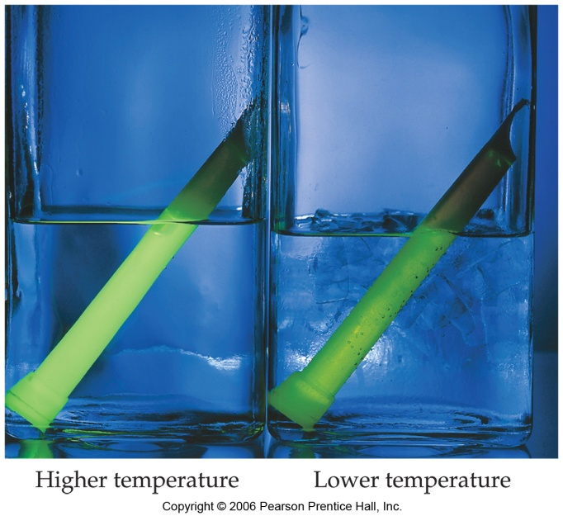
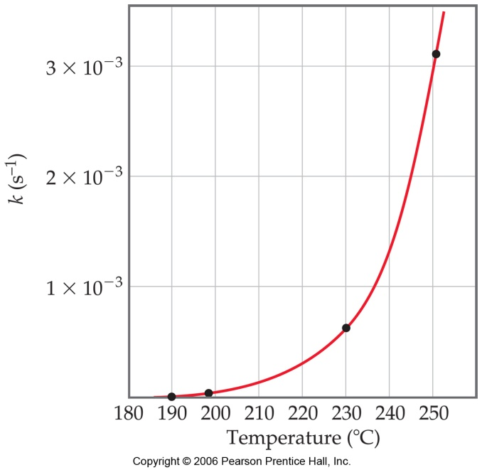
Temperature and Rate
Generally speaking, the reaction rate increases as the temperature increases.
This is because k is temperature dependent.
As a rule of thumb a reaction rate increases about 10 fold for each 10ºC rise in temperature
33.

Slide 34
The Collision Model
In a chemical reaction, bonds are broken and new bonds are formed.
Molecules can only react if they collide with each other.
These collisions must occur with sufficient energy and at the appropriate orientation.
34.

Slide 35
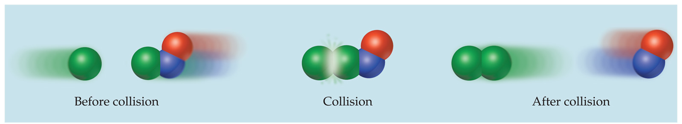
The Collision Model
Furthermore, molecules must collide with the correct orientation and with enough energy to cause bonds to break and new bonds to form
35.

Slide 36
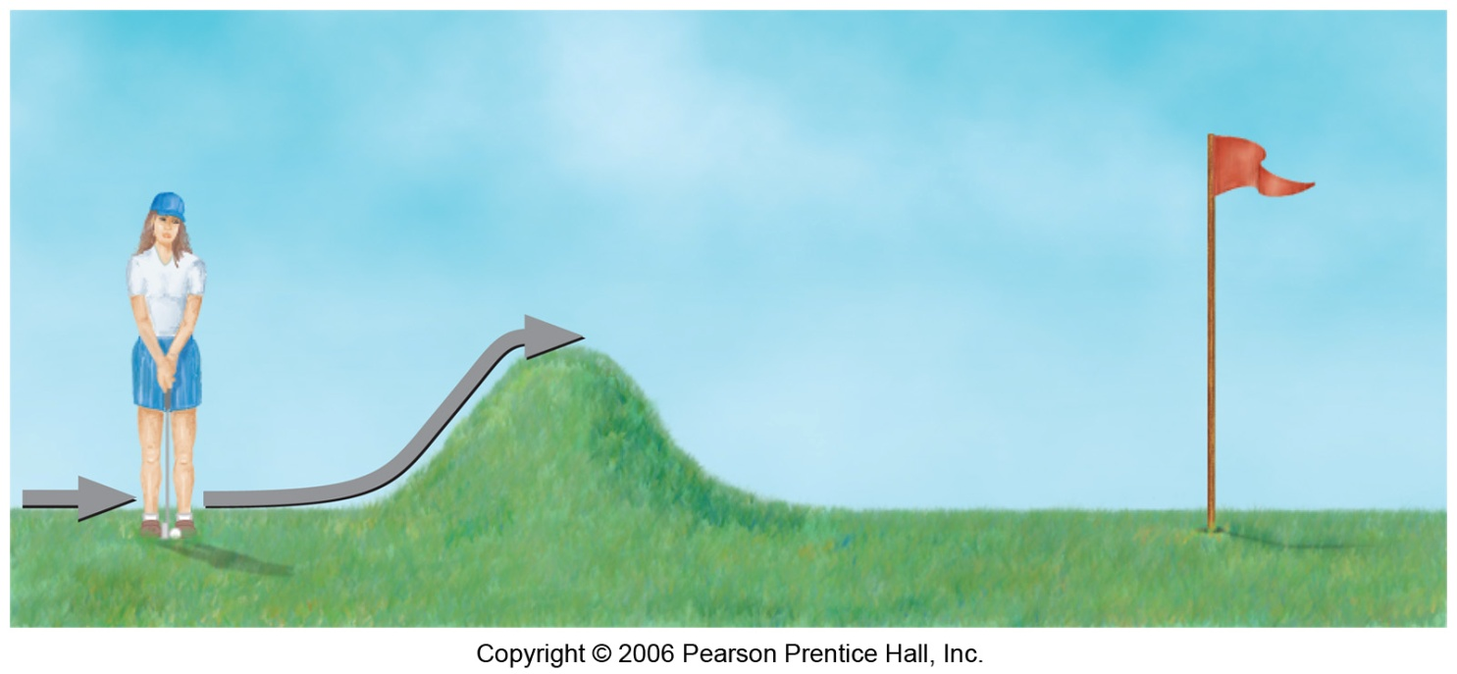
Activation Energy
In other words, there is a minimum amount of energy required for reaction: the activation energy, E_{a}.
Just as a ball cannot get over a hill if it does not roll up the hill with enough energy, a reaction cannot occur unless the molecules possess sufficient energy to get over the activation energy barrier.
36.

Slide 37
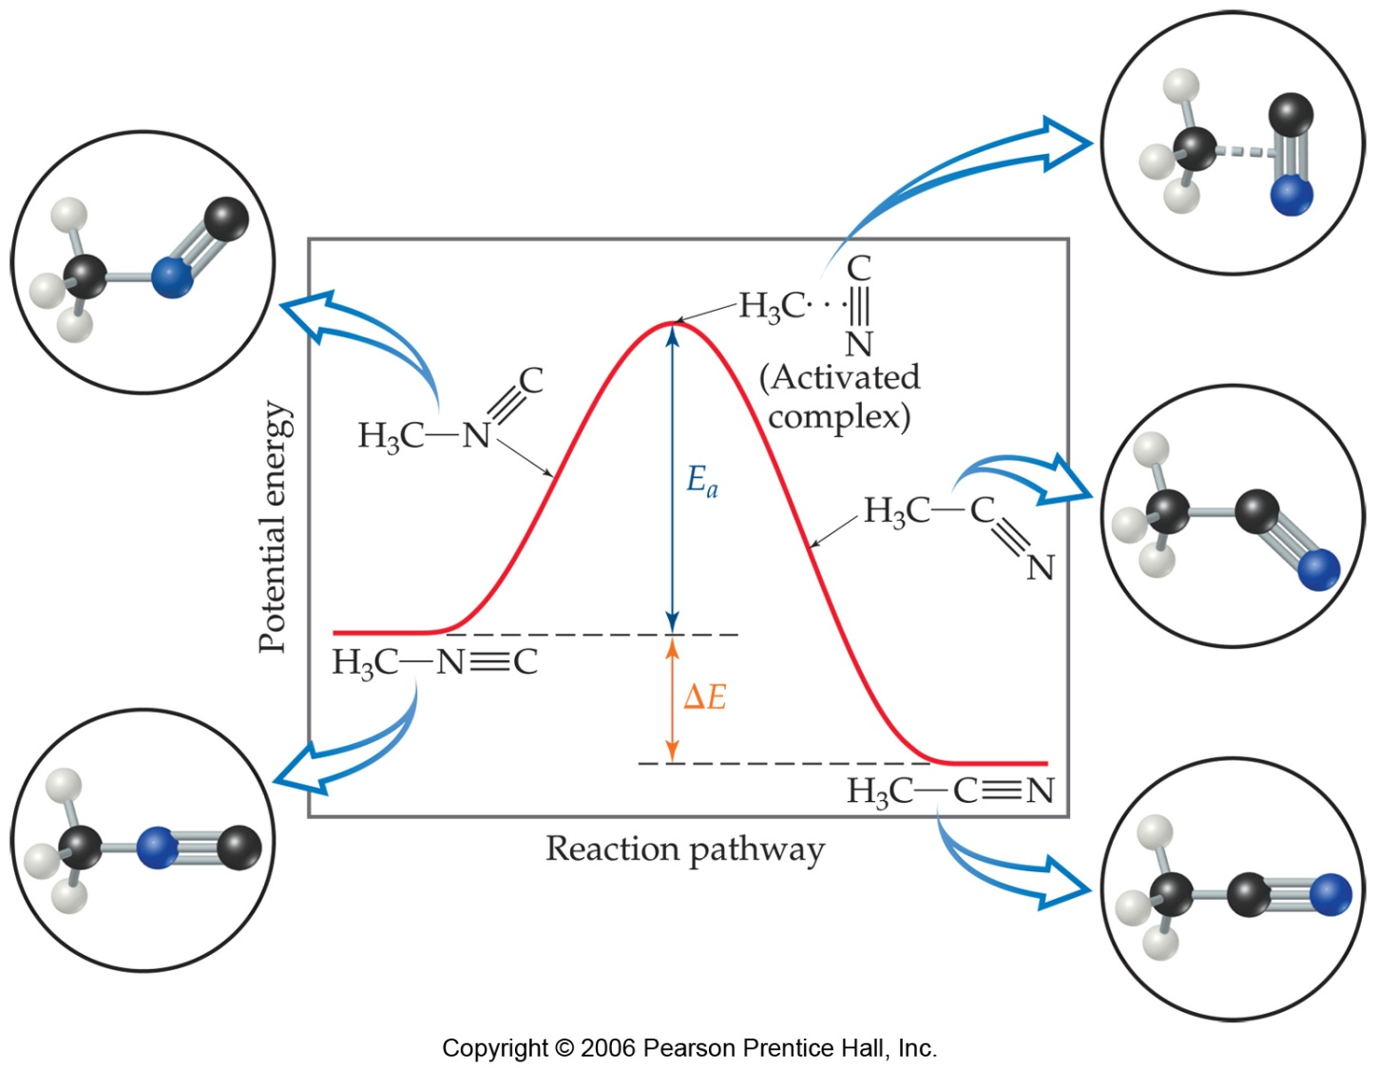
Reaction Coordinate Diagrams
It is helpful to visualize energy changes throughout a process on a reaction coordinate diagram like this one for the rearrangement of methyl isonitrile.
37.

Slide 38

Reaction Coordinate Diagrams
It shows the energy of the reactants and products (and, therefore, ΔE).
The high point on the diagram is the transition state.
The species present at the transition state is called the activated complex.
The energy gap between the reactants and the activated complex is the activation energy barrier.
38.

Slide 39
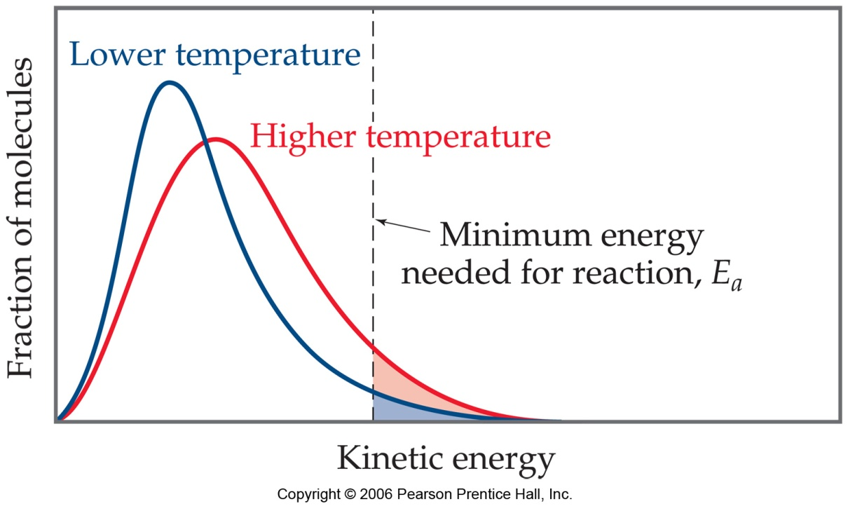
Maxwell–Boltzmann Distributions
Temperature is defined as a measure of the average kinetic energy of the molecules in a sample.
At any temperature there is a wide distribution of kinetic energies.
39.

Slide 40
Maxwell–Boltzmann Distributions
As the temperature increases, the curve flattens and broadens.
Thus at higher temperatures, a larger population of molecules has higher energy.
40.

Slide 41
Maxwell–Boltzmann Distributions
If the dotted line represents the activation energy, as the temperature increases, so does the fraction of molecules that can overcome the activation energy barrier.
As a result, the reaction rate increases.
41.

Slide 42

Maxwell–Boltzmann Distributions
This fraction of molecules can be found through the expression:
where R is the gas constant and T is the temperature in Kelvin .
42.

Slide 43
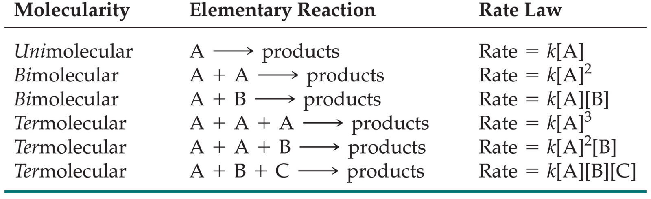
Reaction Mechanisms
The molecularity of a process tells how many molecules are involved in the process.
The rate law for an elementary step is written directly from that step.
43.

Slide 44
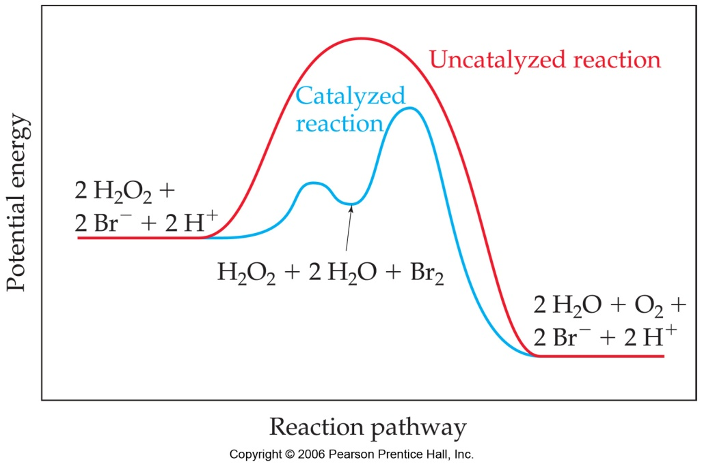
Catalysts
Catalysts increase the rate of a reaction by decreasing the activation energy of the reaction.
Catalysts change the mechanism by which the process occurs.
Some catalysts also make atoms line up in the correct orientation so as to enhance the reaction rate
44.

Slide 45
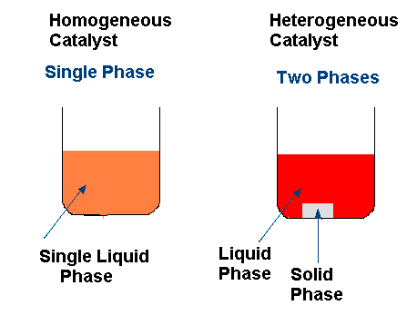
Catalysts
Catalysts may be either homogeneous or heterogeneous
A homogeneous catalyst is in the same phase as the substances reacting.
A heterogeneous catalyst is in a different phase
45.

Slide 46
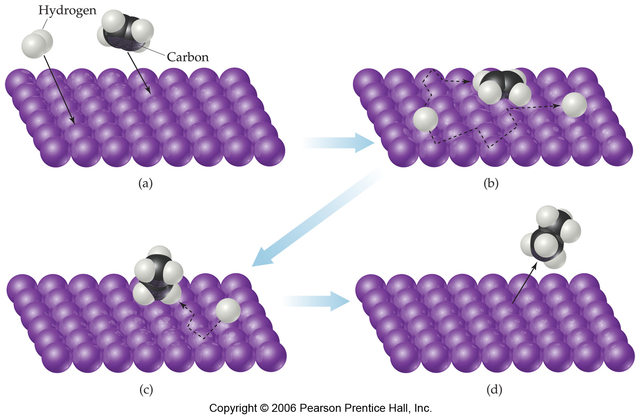
Catalysts
One way a catalyst can speed up a reaction is by holding the reactants together and helping bonds to break.
Heterogeneous catalysts often act in this way
46.

Slide 47
Catalysts
Some catalysts help to lower the energy for formation for the activated complex or provide a new activated complex with a lower activation energy
AlCl₃ + Cl₂ → Cl⁺ + AlCl₄⁻
Cl⁺ + C₆H₆ → C₆H₅Cl + H⁺
H⁺ + AlCl₄⁻ → HCl + AlCl₃
_{Overall reaction}
C₆H₆ + Cl₂ → C₆H₅Cl + HCl
47.

Slide 48
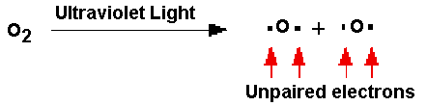


Catalysts & Stratospheric Ozone
In the stratosphere, oxygen molecules absorb ultraviolet light and break into individual oxygen atoms known as free radicals
The oxygen radicals can then combine with ordinary oxygen molecules to make ozone.
Ozone can also be split up again into ordinary oxygen and an oxygen radical by absorbing ultraviolet light.
48.

Slide 49
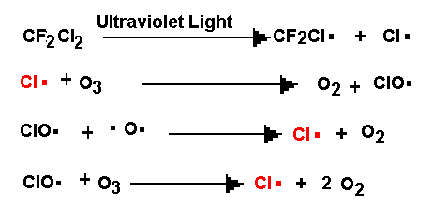
Catalysts & Stratospheric Ozone
The presence of chlorofluorcarbons in the stratosphere can catalyze the destruction of ozone. UV light causes a Chlorine free radical to be released
The chlorine free radical attacks ozone and converts it
Back to oxygen. It is then regenerated to repeat the
Process. The result is that each chlorine free radical can
Repeat this process many many times. The result is that
Ozone is destroyed faster than it is formed, causing its level to drop
49.

Slide 50
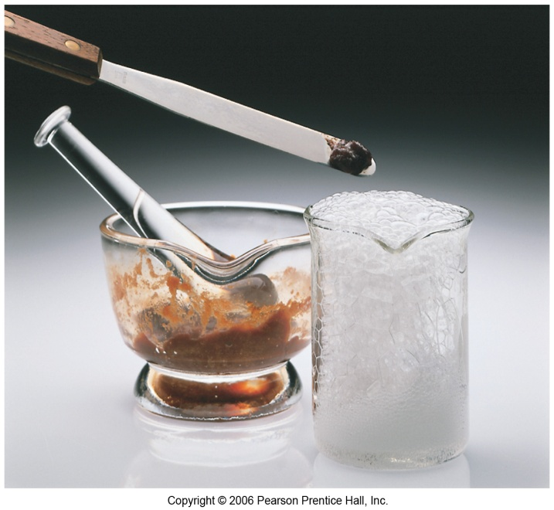
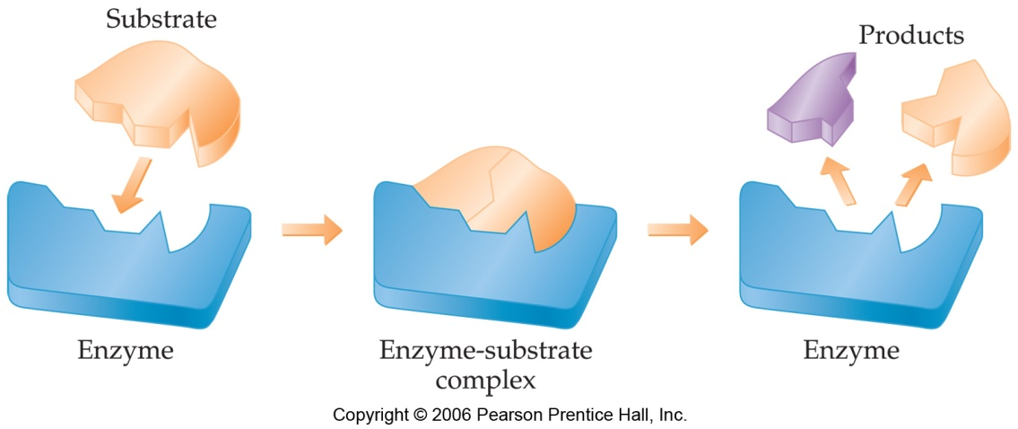
Enzymes
Enzymes are catalysts in biological systems.
The substrate fits into the active site of the enzyme much like a key fits into a lock.
50.

